Slide 1


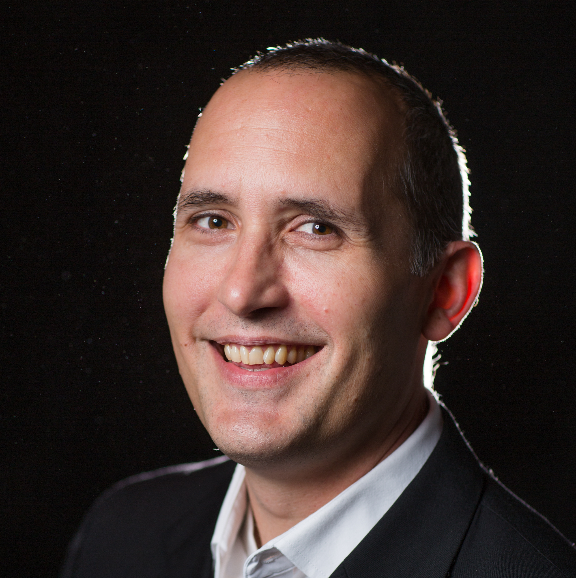
Evangelism for the
Next Generation
REACH THE ”NONES” IN
YOUR COMMUNITY
Join InterVarsity Regional Director Jason Gaboury for a free webinar for pastors & church leaders.
Thursday, Feb. 13 // 2:00 PM EST
Notes:
Photo can be removed or replaced with your own if you have a featured guest at your event. Make sure it is cropped to a square like the example. You can use your InterVarsity chapter/event logo in place of the standard logo. Please make sure to use Avenir LT Std and that you have it installed on your computer.

